Slide 1

Buzy Beez

Slide 2
Opportunity Statement
Given that many students struggle to balance extra-curriculars, how might we help 14-18 year-olds who are high-achieving and pressured by parents and peers to effectively choose which extra-curriculars to do in order to live more joyous lives.
Notes:
How it addresses the problem
Target demographic
Stakeholders
The solution

Slide 3

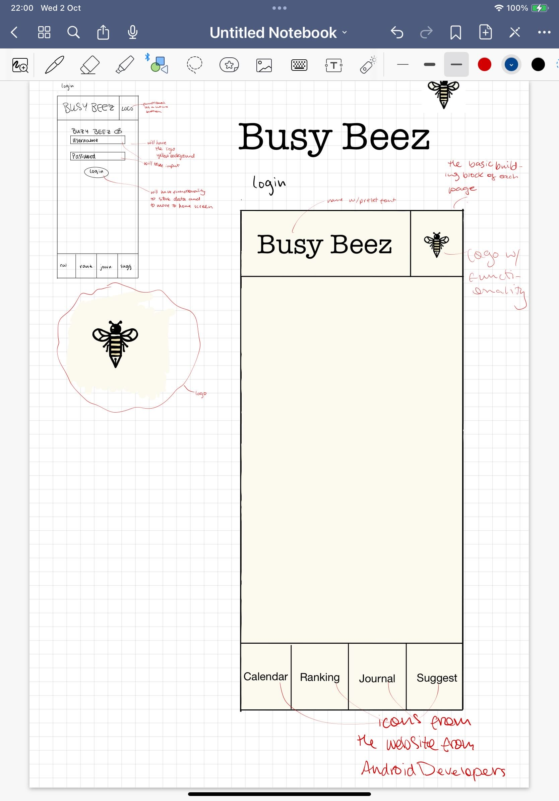
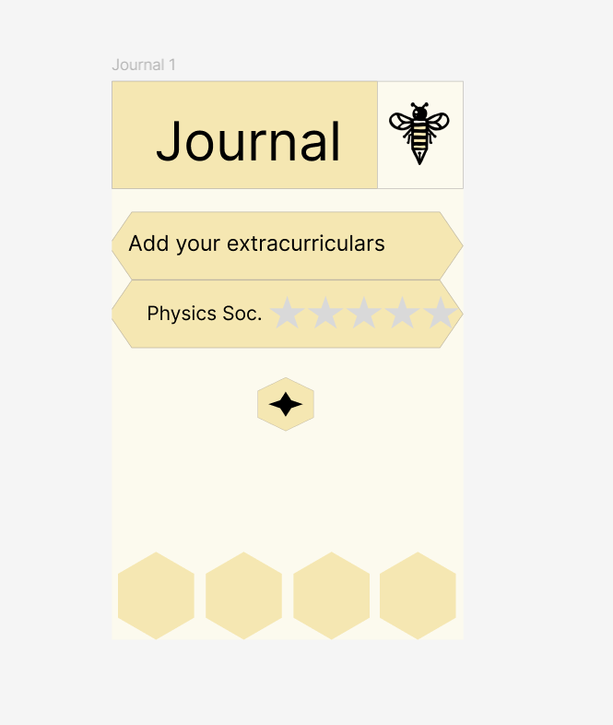

Design

Slide 4
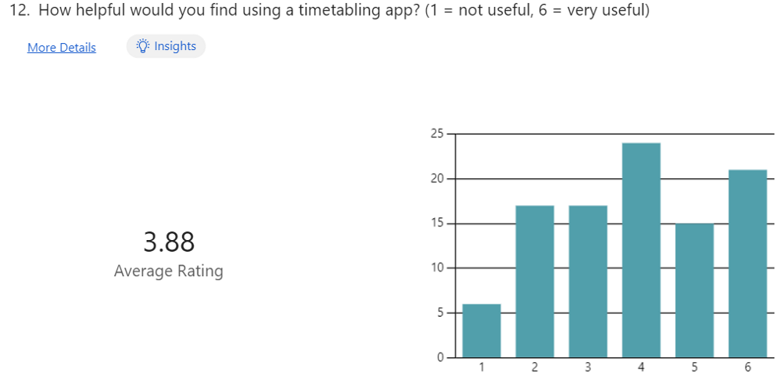
Research
 | free | For students | Planner/organiser | Choose clubs | Speak to advisors
Our app
Extracurriculars.org
Crimson Education
Clipboard
ActivityHub
MyStudentLife
Bookitit
Trello

Slide 5
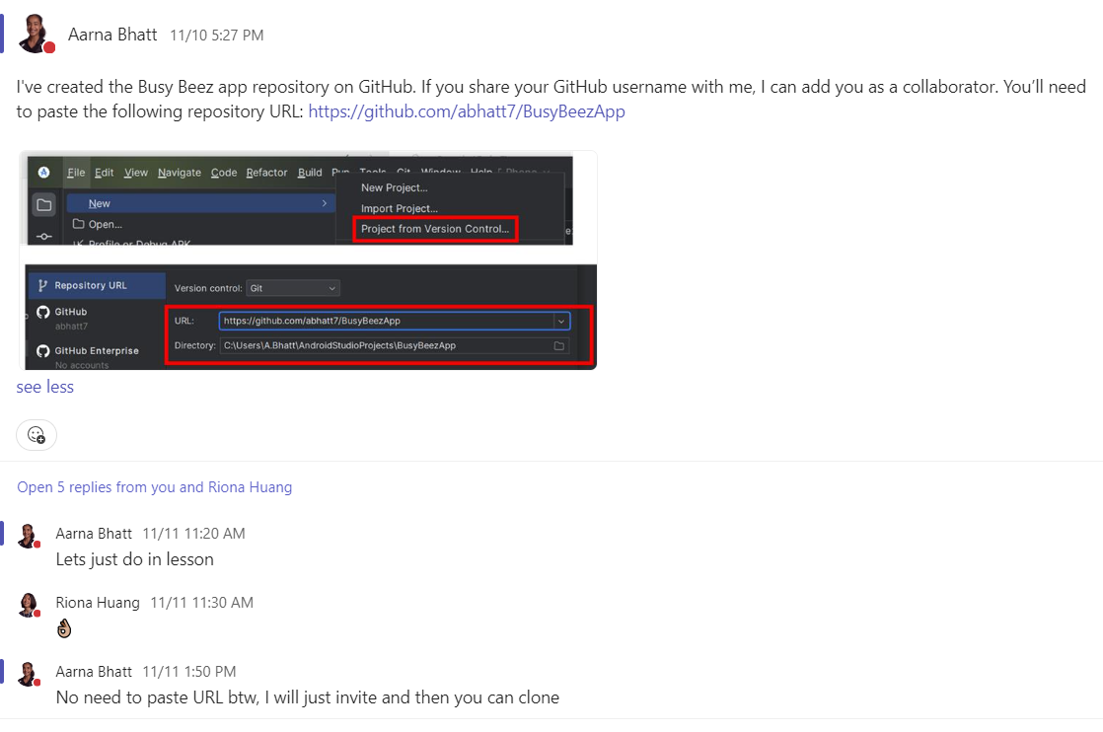
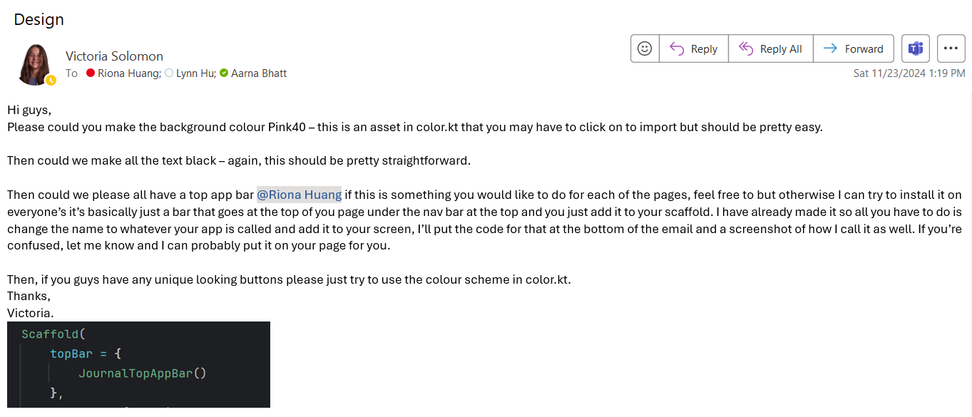
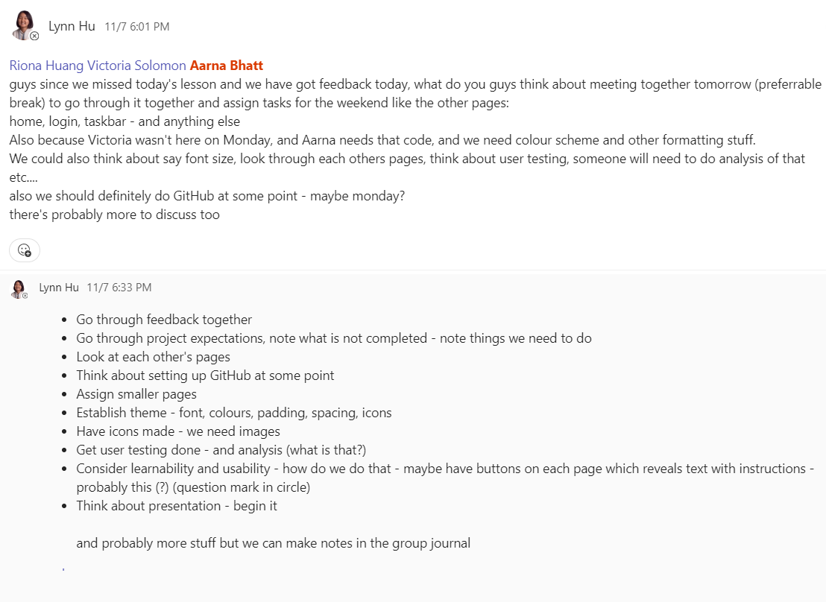
Teamwork and collaboration

Slide 6
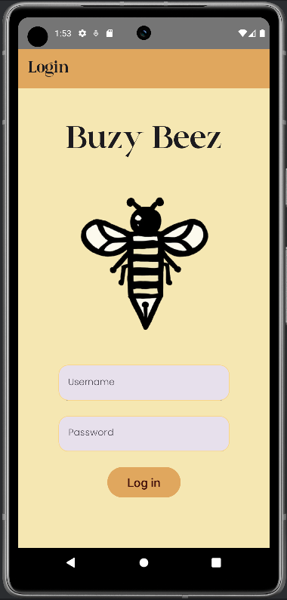
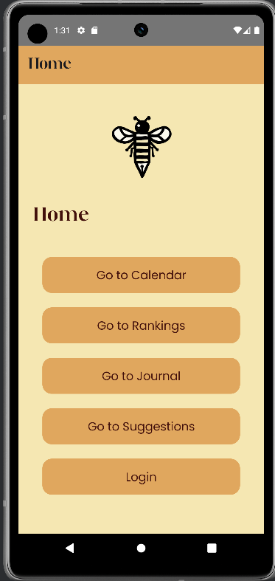
Home and Login Screen

Slide 7
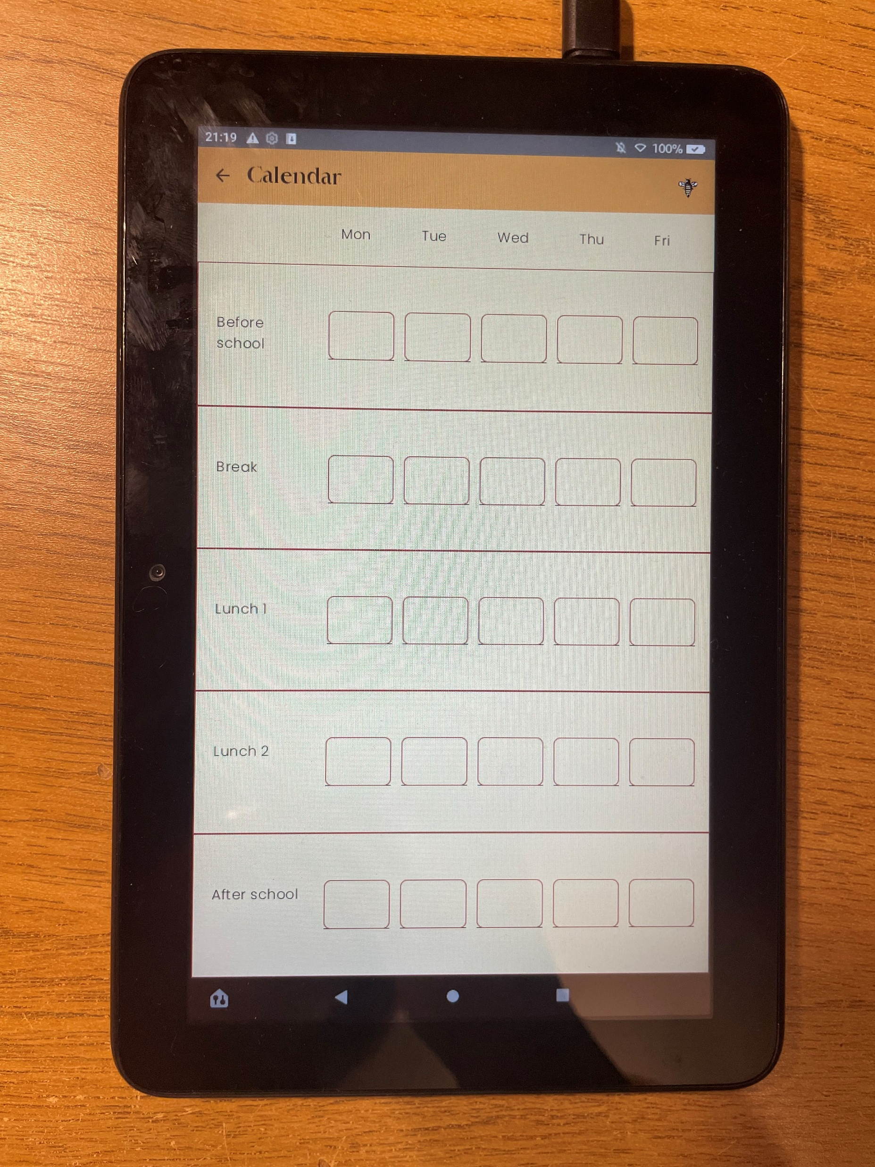
Calendar

Slide 8
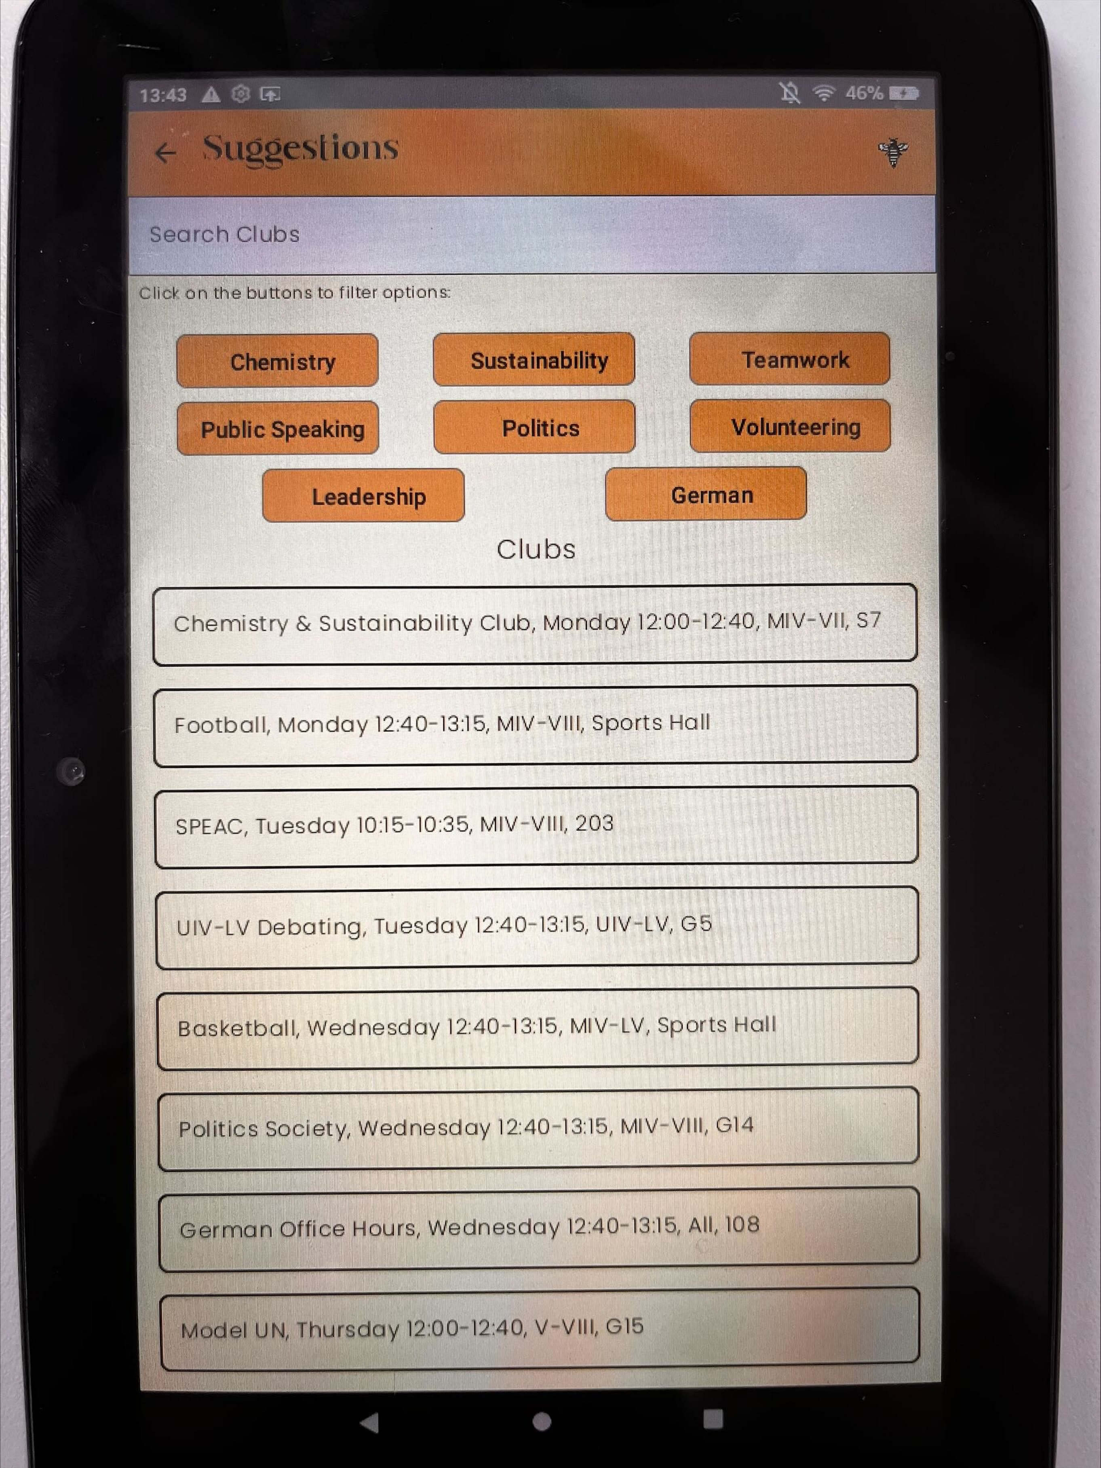
Suggestions

Slide 9
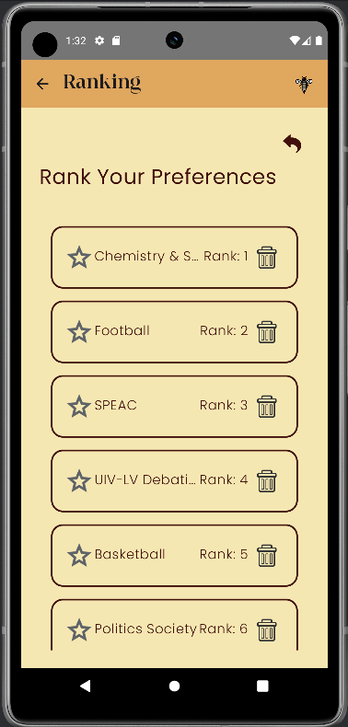
Ranking

Slide 10
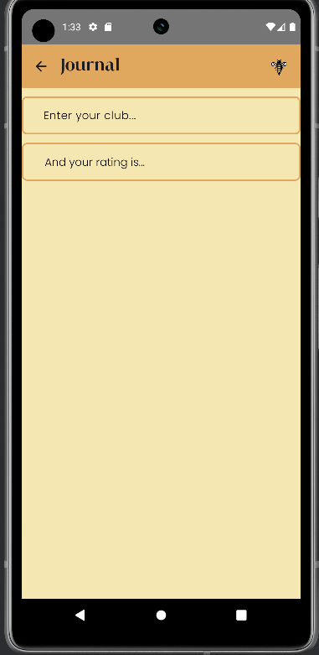
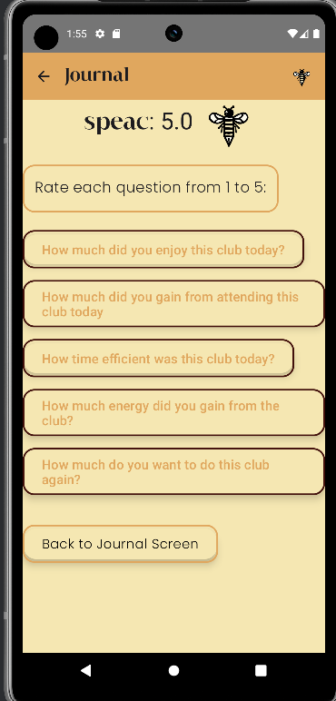
Journal Screens

Slide 11
Future
More accessibility
Database from schools
Personal accounts
Widgets
Partner with companies/schools/universities

